Slide 1
Movie Text Mining
Marie Hasegawa

Slide 2
Project Objective
The purpose of this project is to use text mining techniques to analyze movie Descriptions from the dataset, IMDB_movies.csv, which is stored under the dataframe variable, movies_desc.
Tokenization (TF-DF) is used to analyze term frequencies in movie descriptions in order to determine the conceptual theme of a movie franchise.
Determine the mixture of terms that is associated to every topic and the mixture of topics that characterizes each document with Topic Modeling in the dataset, IMDB_movies.csv.
Sentimental Analysis regarding Movies with Sentimental clusters will use bing and nrc lexicons to see how Sentiment affects Rating and Revenue.
The Movies network of bigrams help summarize how frequented Movie Description word-relations are connected within other movies.

Slide 3
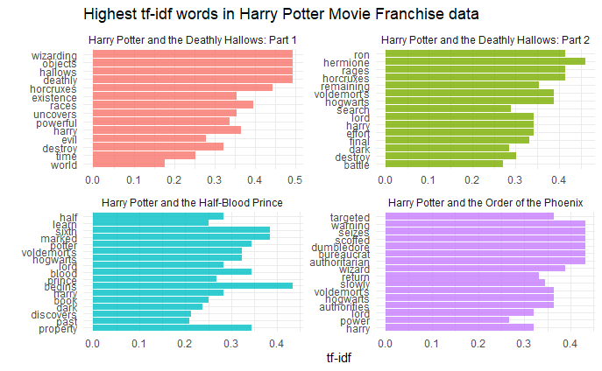
Tokenization (TD-IDF)
Topic 1
The term, life, has the highest beta level of 0.010060437, which suggests that the term, life, is the most common term in Topic 1.
For Topic 2
The term, family, has the highest beta level of 0.007863619, which suggests that the term, family, is the most common term in Topic 2.
For Topic 3
The term, life, has the highest beta level of 0.012327667, which suggests that the term, life, is the most common term in Topic 3.
For Topic 4
The term, story, has the highest beta level of 0.013904911, which suggests that the term, story, is the most common term in Topic 4.

Slide 4
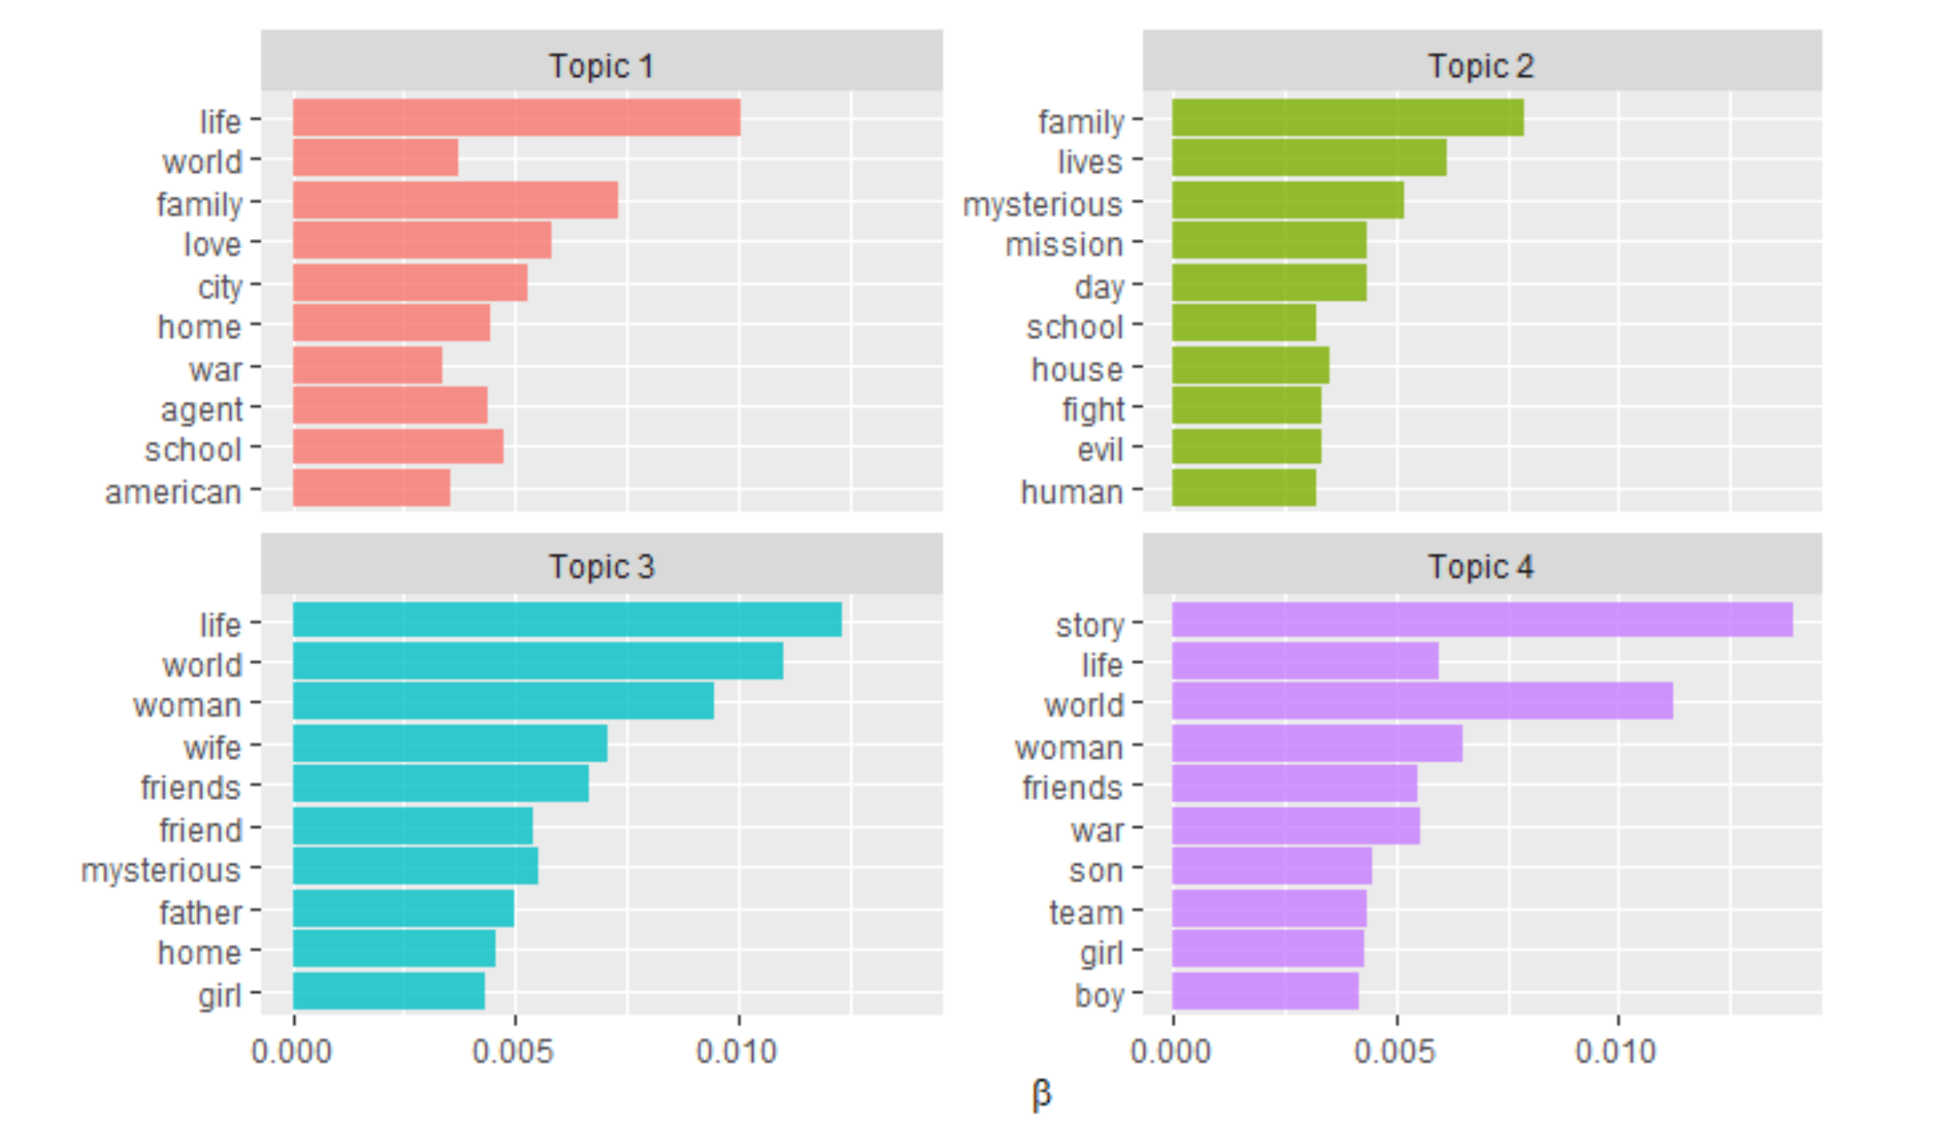
Topic Modeling
Topic 1
The term, life, has the highest beta level of 0.010060437, which suggests that the term, life, is the most common term in Topic 1.
For Topic 2
The term, family, has the highest beta level of 0.007863619, which suggests that the term, family, is the most common term in Topic 2.
For Topic 3
The term, life, has the highest beta level of 0.012327667, which suggests that the term, life, is the most common term in Topic 3.
For Topic 4
The term, story, has the highest beta level of 0.013904911, which suggests that the term, story, is the most common term in Topic 4.
Class | Group 1 | Group 2
Class 1 | 82 | 95
Class 2 | 76 | 88
Class 3 | 84 | 90

Slide 5
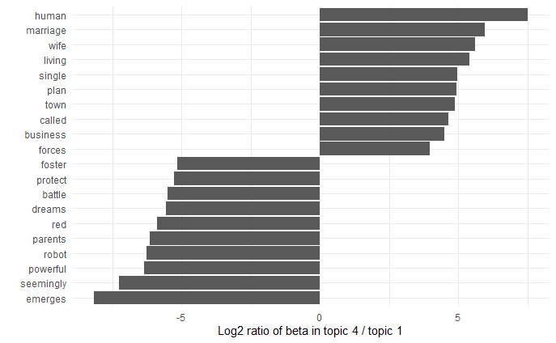
Topic Modeling
The two topics from the algorithm identified domestic and battle-ready movie concepts.
The most common words in topic 4 include domestic concepts, while the words most common in topic 1 was more related to battle-ready concepts.

Slide 6
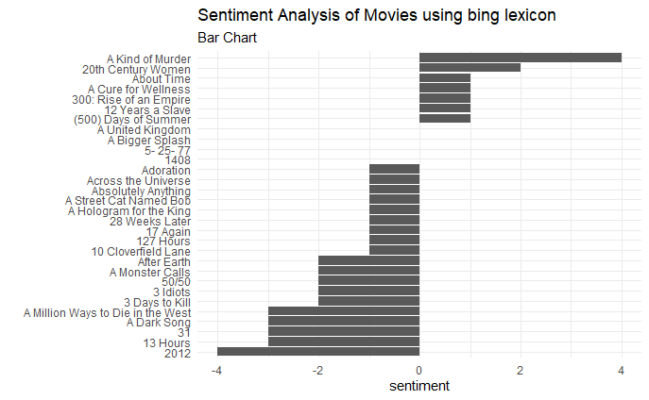
Sentimental Analysis using Bing Bar Chart
The lexicon, bing, scores a term sentiment as either positive or negative.
The table, bing_movie, is a modified table of movie_stop_rem with 3 added Sentiment columns: negative, positive, and sentiment.
In the bar chart above, it shows the first 30 movies from the table, bing_movie, and illustrates every movie’s sentiment value.
A huge majority of the movies have a negative bing sentiment value.
The movie with the highest positive bing sentiment is called A Kind of Murder with a sentiment value of 4, while the movie with the lowest bing sentiment value is called 13 Hours with a sentiment value of -4.

Slide 7
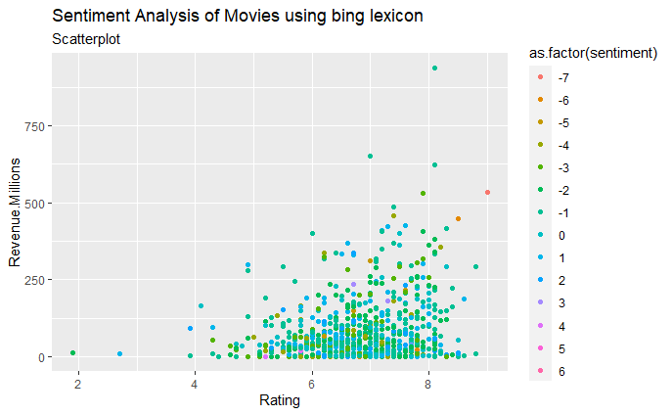
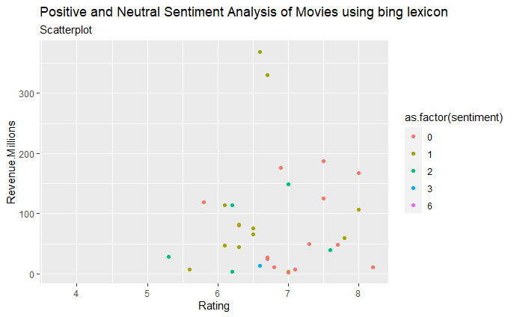
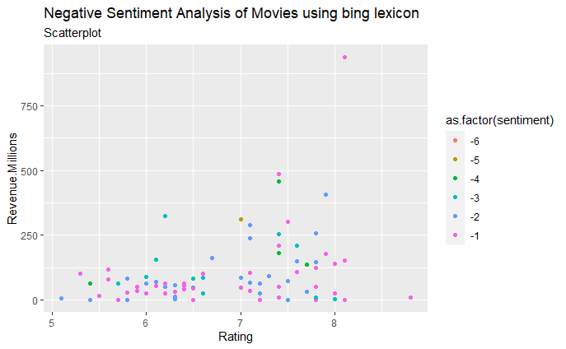
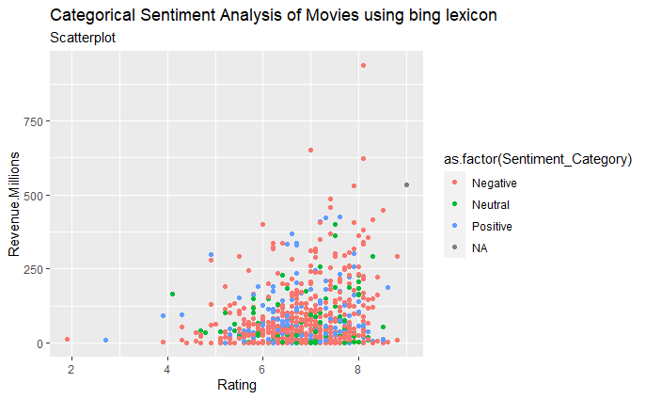
Sentimental Analysis using Bing Scatter Plots
Sentiment Analysis of Movies
Most films are described in a mostly negative sentiment range of -4 to 2. Most highly rated and profitable movies are described in a negative sentiment of around -1 to -3.
Even though the graph has given good data for analysis, it lacks specification and precision since the plots and colors are too blended to differentiate between the other plots.
Positive and Neutral Sentiment Analysis of Movies
The scatterplot above shows the plots in relation to Rating and Revenue with clusters of positive (1 to 6) and neutral (0) bing sentiment. The graph doesn’t seem to have a significant shape to make an inference.
Negative Sentiment Analysis of Movies
The scatterplot above shows the plots in relation to Rating and Revenue with clusters of negative (-6 to -1) bing sentiment.
The bing sentiments, -1 and -2, have the highest Revenue and Rating in the negative sentiment scatterplot.
Categorical Sentiment Analysis of Movies
The scatterplot shows that the negative bing sentiment dominates more frequently than positive and neutral bing sentiment.
Not to mention, that the negative sentiment is the most likely sentiment to have a high Revenue and Rating.
The graph is a categorical bing sentimental scatterplot that clusters the plots by Sentinment_Category with 3 categories: Negative (-6 to -1), Neutral (0), and Positive (1 to 6).

Slide 8
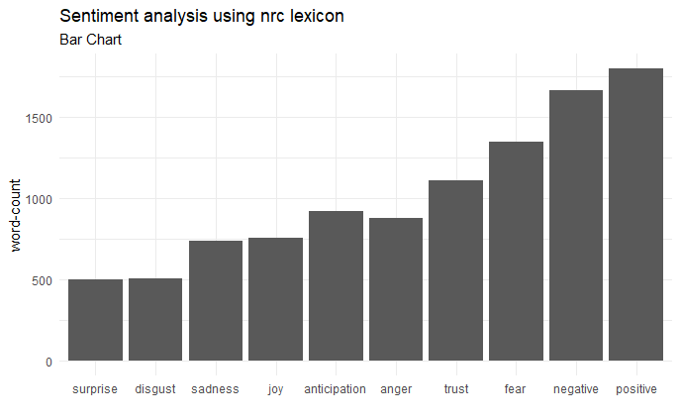
Sentimental Analysis using nrc Bar Chart
The graph above is a bar chart from the dataframe, nrc_movie, which counts the word frequency of the nrc sentiment category.
The lexicon, nrc, categorizes a term under a sentiment type category: positive, negative, anger, anticipation, disgust, fear, joy, sadness, surprise, and trust.
The highest frequented, nrc sentiment, is positive, while the lowest frequented nrc sentiment is surprise.

Slide 9
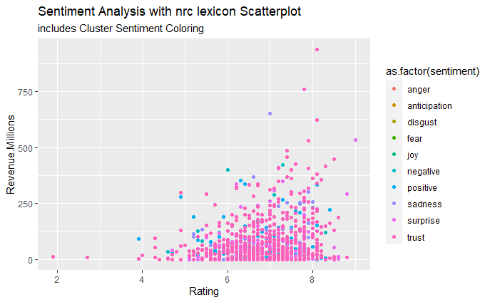
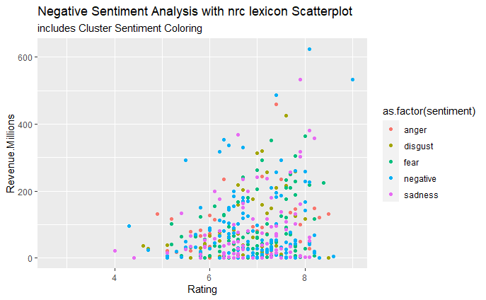
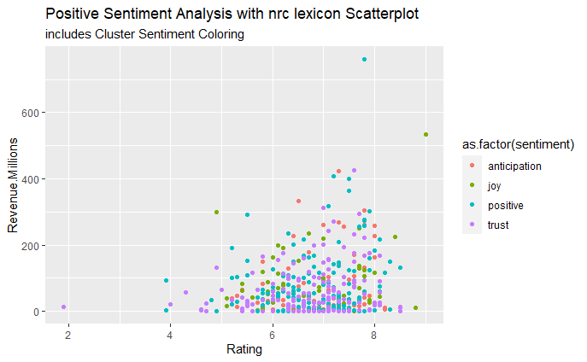
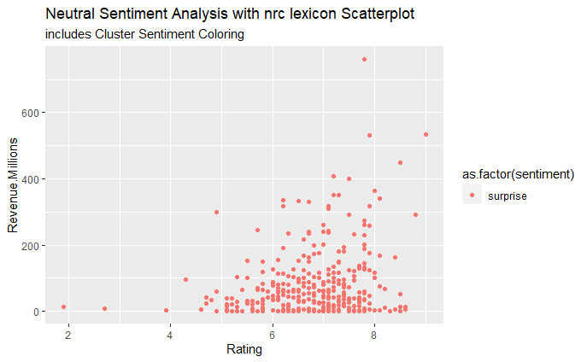
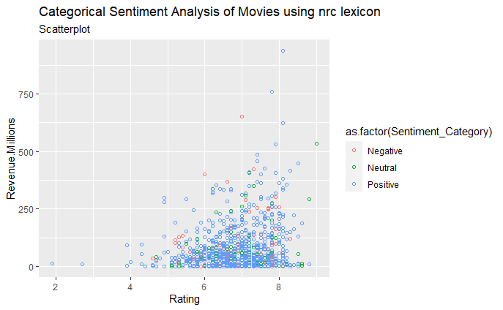
Sentimental Analysis using nrc Scatterplot
Sentiment Analysis of Movies
Based on the visual, it seems that the movie Descriptions are dominated by the nrc sentiment surprise and trust. which most likely nrc sentiment to have a high Revenue and Rating
Positive Sentiment Analysis of Movies
The scatterplot shown above is in regard to positive nrc sentiments with 4 categories: anticipation, joy, positive, trust.
The graph is only concentrated by the positive sentiments, trust and positive, which shows that that the most highly rated and highly profitable movies that have positive sentiment descriptions have terms related to having nrc lexicons called positive and trust.
Negative Sentiment Analysis of Movies
The graph is being dominated by the negative sentiments, negative and sadness, which shows that that the most highly rated and highly profitable movies that have negative sentiment descriptions have terms related to having nrc lexicons called negative and sadness.
Also, the plots are accumulating in the Rating range of ~4 to ~9 with a Revenue range of ~0 to ~610 million.
Neutral Sentiment Analysis of Movies
The scatterplot shown above is excludes positive and negative nrc sentiments with 1 category: surprise, since it’s the only category that wasn’t place as positive or negative in the article, NRC Word-Emotion Association Lexicon.
The graph is only concentrated by the neutral sentiment, surprise, which shows that it has a Rating range of ~5 to ~9 with some outliers, and a Revenue range of ~0 to ~400 with some outliers.
Categorical Sentiment Analysis of Movies
The scatterplot shows that the negative bing sentiment dominates more frequently than positive and neutral bing sentiment.
Not to mention, that the negative sentiment is the most likely sentiment to have a high Revenue and Rating.

Slide 10
Conclusion
This project explored text mining techniques in order to develop relational analysis concerning movie Description terms from the dataset, IMDB_movies.csv.
Tokenization (TF-DF) was used to increase efficiency to analyze term frequencies in movie Descriptions
Create mixtures of terms that are correlated to every topic and the mixture of topics that distinguishes each document through Topic Modeling in the dataset
Sentimental Analysis focused on Movies with Sentimetal Clusters that were used bing and nrc lexicons to see how Sentiment affects Rating and Revenue.
The network of bigrams for the Movies dataset help summarize how frequented Movie Description word-terms create term relationships and how they connect to other movies.

